Slide 1
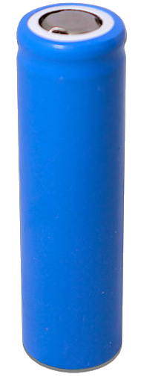
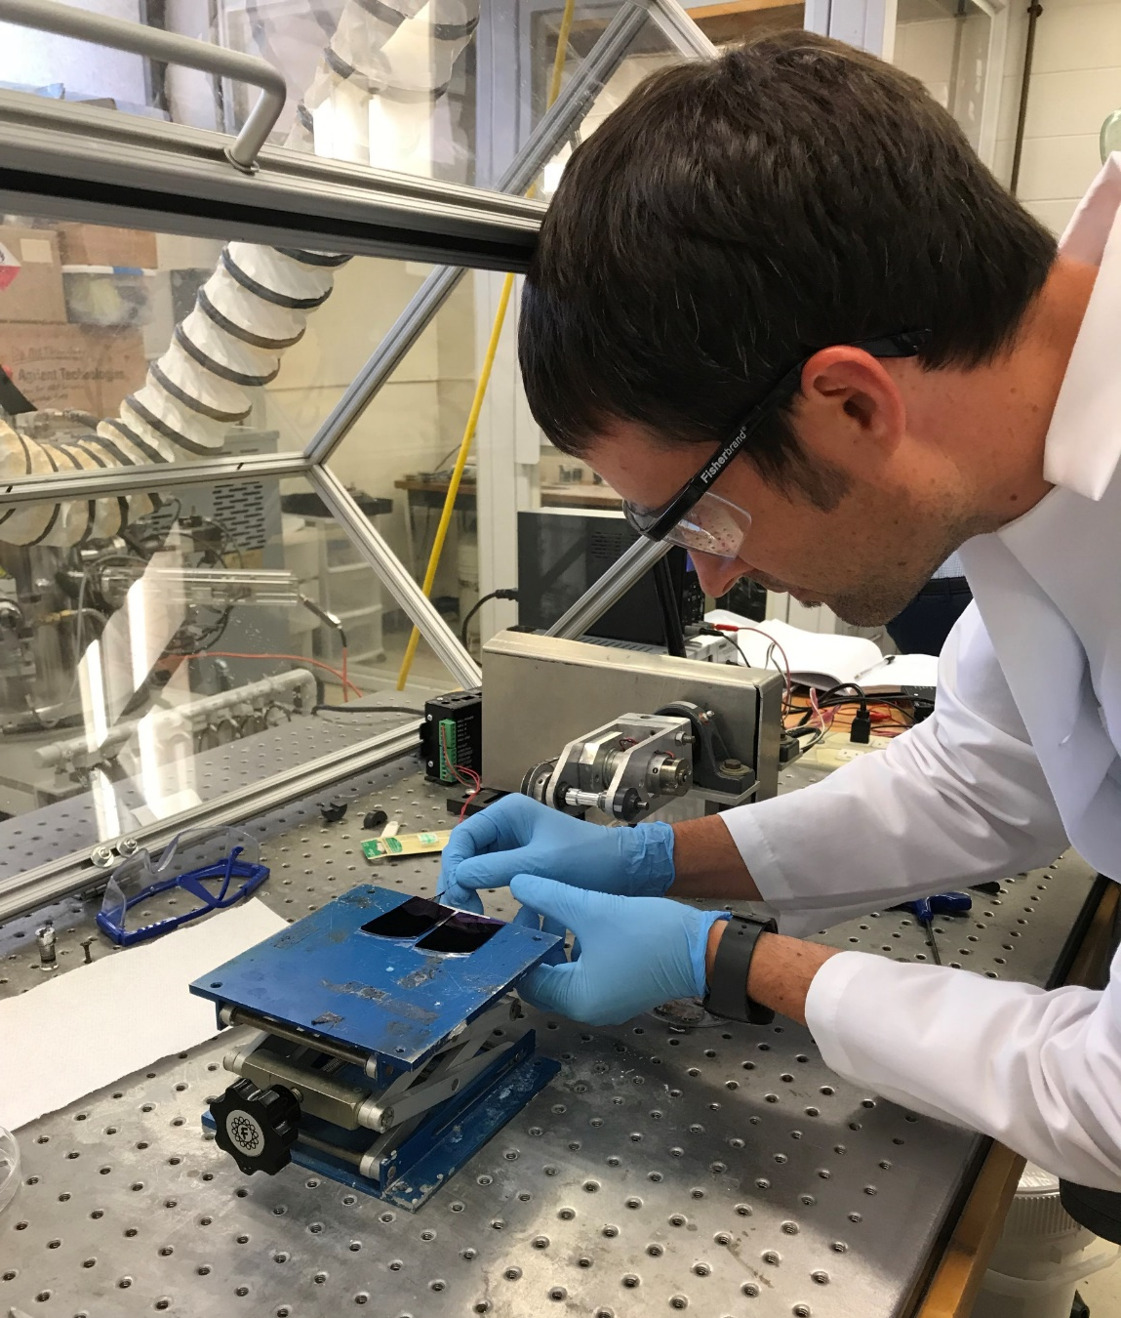
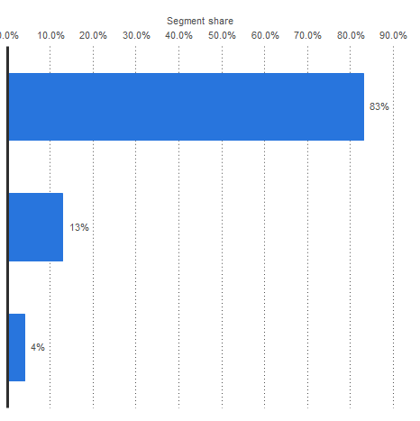
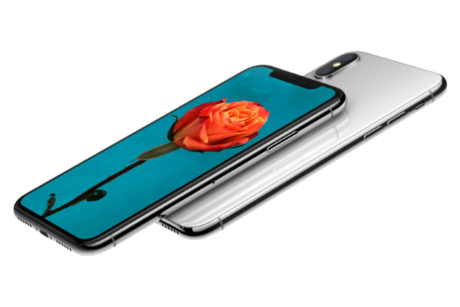
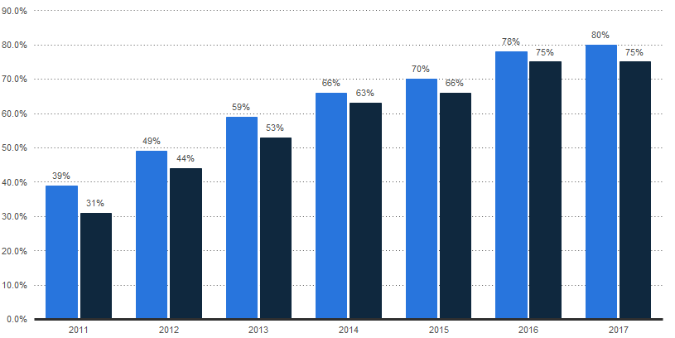
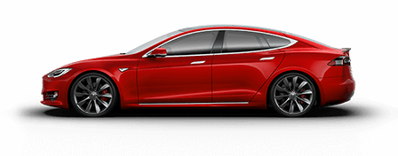
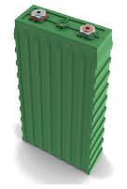
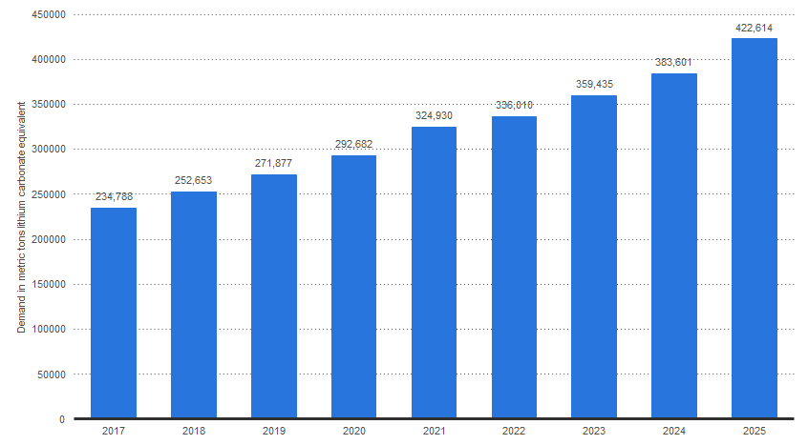
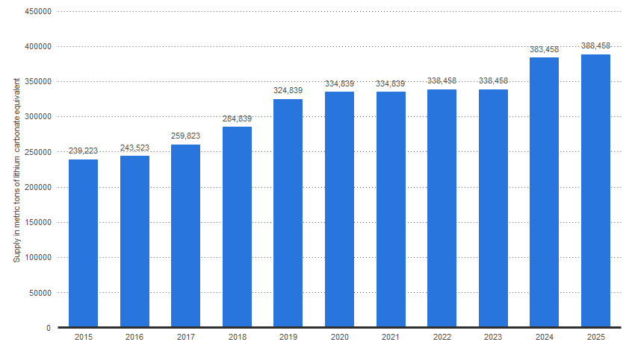
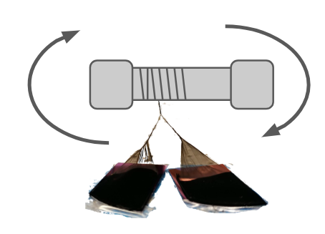
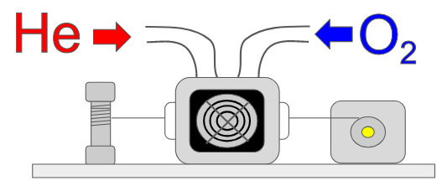
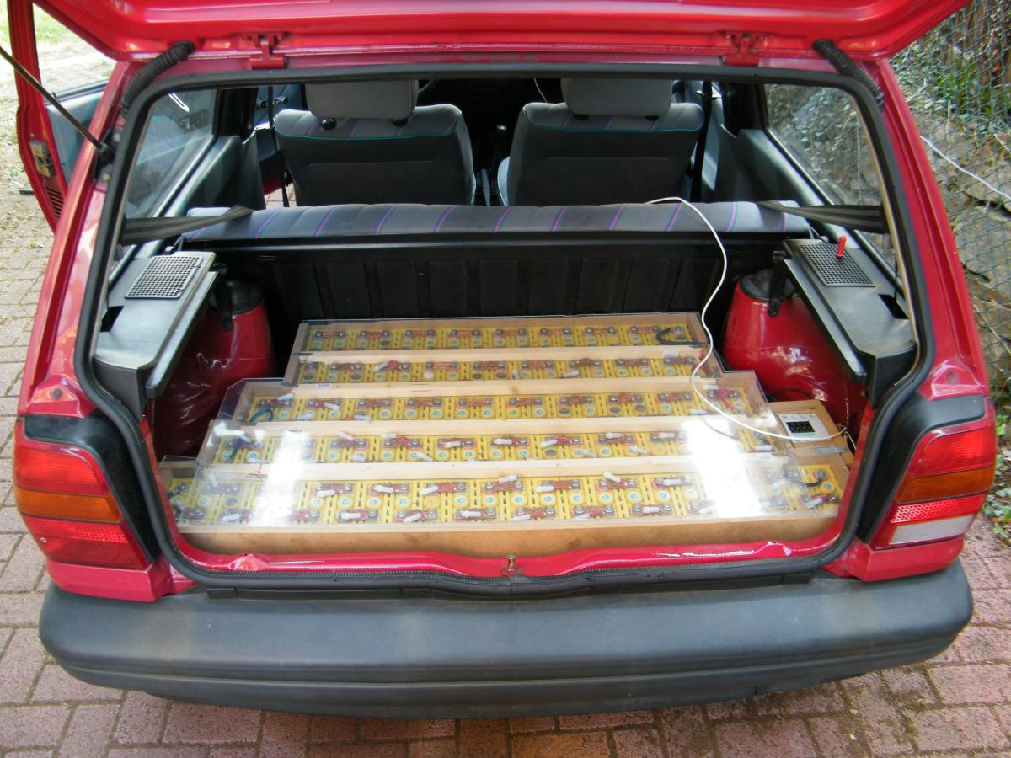
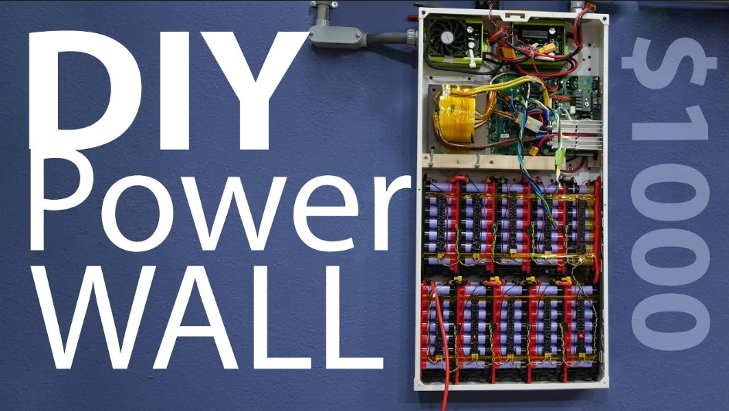
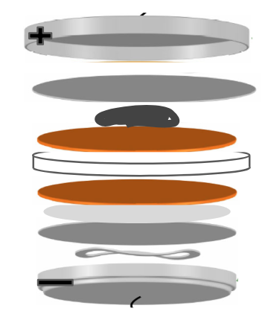
Lithium-Ion Batteries Aaron Debbink Indian Hill High School AP Physics 2
RET is funded by the National Science Foundation, grant # EEC-1710826.
Summer
Research
Teaching
Strategies
The Big Idea
Big Idea
Essential Questions
Challenge
Needed Battery Advancements:
Challenge Based Learning:
How are Lithium-ion Batteries Used?
Percentage of Smartphone Users in the US
Energy-density
Power-density
Environmentally sustainable
Flexibility
83%
66%
63%
70%
66%
78%
75%
80%
75%
Mobile
49%
44%
59%
53%
13%
39%
31%
Guiding Questions
Engineering Design
Communicate Solution
Automotive
2011
2012
2013
2014
2015
2016
2017
Industrial
4%
= males
= females
Research Goals:
Spinning carbon nanotube thread
https://www.statista.com/statistics/606507/lithium-battery-use-globally-by-application/
https://www.statista.com/statistics/194998/percentage-of-us-smartphone-owners-by-gender/
Global Lithium Demand:
Global Lithium Supply:
Create a cathode for a lithium-sulfur fiber battery which has high conductivity and tensile strength
422,614 TONS
388,458 TONS
Student input used to shape investigation
237,788 TONS
2025
239,223 TONS
2025
Spinning CNT Thread
2017
2017
Carbon nanotube (CNT) Array
Engineering Design Process:
https://www.statista.com/statistics/452025/projected-total-demand-for-lithium-globally/
https://www.statista.com/statistics/452026/projected-total-supply-for-lithium-globally/
What can be done?
Oxygen Plasma Functionalization
Sulfur Melting Infiltration
Reuse
Electric Car Conversion
Scanning Electron Microscope Image of Hybrid Li-S Battery Cathode
Multiple attempts to find solution
Multiple solutions are valid
Recycle
Coin Cell Battery Assembly
Battery for Solar Energy Storage

